Slide 1
A Challenge Set and Methods for Noun-Verb Ambiguity
Ali Elkahky, Kellie Webster, Daniel Andor, and Emily Pitler
Google AI Language

Slide 2
Question Statement
Consider the ambiguous examples below:
(1) Certain insects can damage plumerias, such as mites, flies, or aphids.
(2) Mark which area you want to distress.
Models trained on the WSJ Penn Treebank can only recognize flies as verbs, and mark as nouns.
All occurrences of flies and mark in WSJ are the same.
Most special uses of these words hardly appear in the training data.
This is called Noun-Verb Ambiguity.

Slide 3
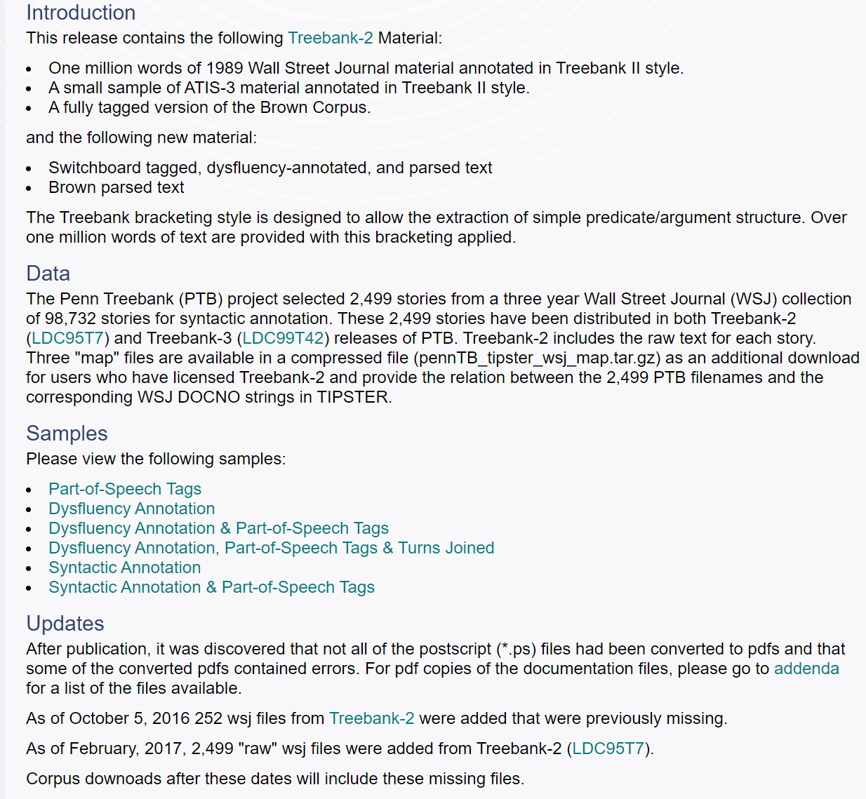
https://catalog.ldc.upenn.edu/LDC99T42

Slide 4
Question Statement
Except for training data, the tagger itself should take into account the surrounding context in order to correctly tag ambiguous words, rather than skewed priors per word type.
A simple tagger based on a single hidden layer feed-forward neural network with 128 units that uses a three word window around the focus token as features achieves an accuracy of 97.0% on the WSJ ambiguous words.
A more complex model which incorporated contextual information may help alleviate the problem.
In summary, two types of actions can be taken to enhance the tagger’s ability to disambiguate verbs and nouns.
Construct a more challenging dataset which captures a wide range of possibilities that a part-of-speech tagger needs to handle in the wild.
Build a more robust model which incorporates global contextual information to accurately tag part-of-speeches.

Slide 5
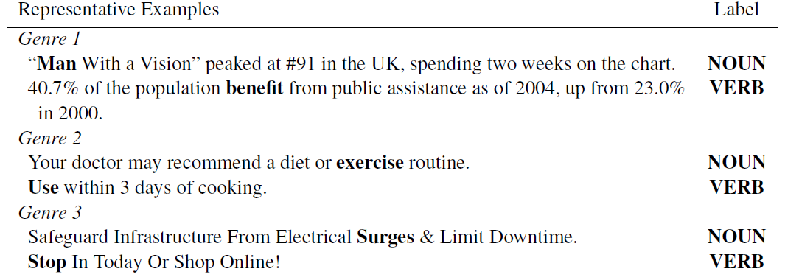
Dataset Construction
Step 1: Naturally Occurring Sources
Genre 1: long well-edited sentences
Genre 2: heavy use of imperative verbs
Genre 3: headline style short sentences

Slide 6
Dataset Construction
Step 2: Ambiguous Token Detection
Step 3: Filtering Trivial Examples
Exclude tokens preceded by a determiner (a/the) or modal verb (can/will).
Tokens were additionally restricted to be neither adjectival modifiers nor components of noun-compounds.
Step 4: Diversification
Sentence-initial imperative verbs were very likely to be confidently tagged as nouns. To ensure that this important class of ambiguous tokens was included in our dataset, we made it a special extraction case and did not apply the above filters for trivial examples.
Step 5: Crowdsourced Annotation
Annotators were asked to select whether the target word was a “Noun”, a “Verb”, “Ambiguous”, or “Neither”.

Slide 7
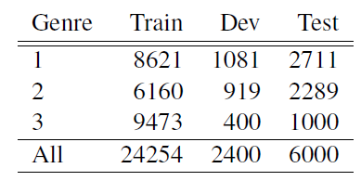
Dataset Construction
Step 6: Final Dataset
Reject examples in which there was no majority agreement or in which the majority label was “Ambiguous” or “Neither”.
Linguists found only 7 actual mistakes over 200 example (3.5% of examples).

Slide 8
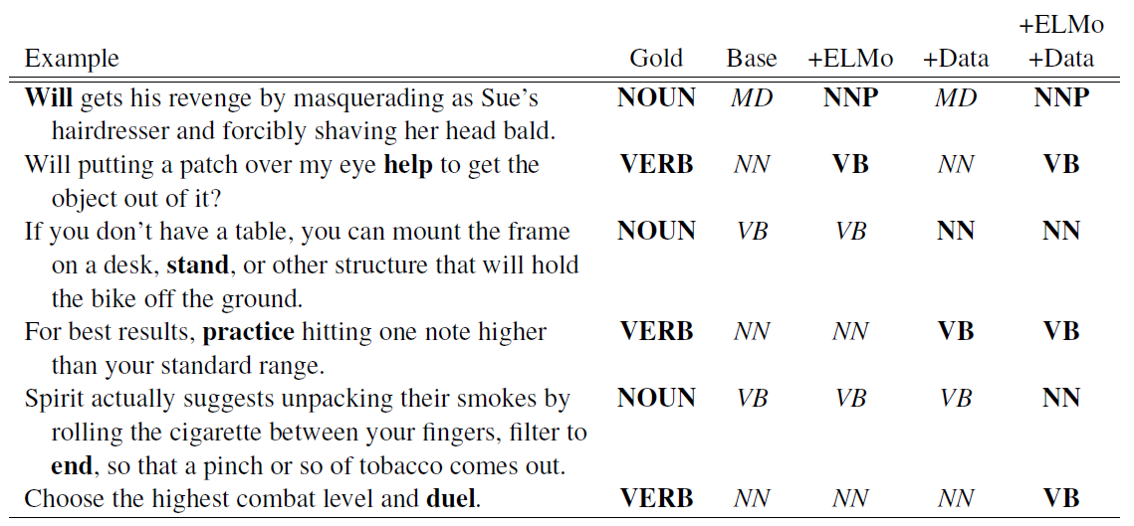
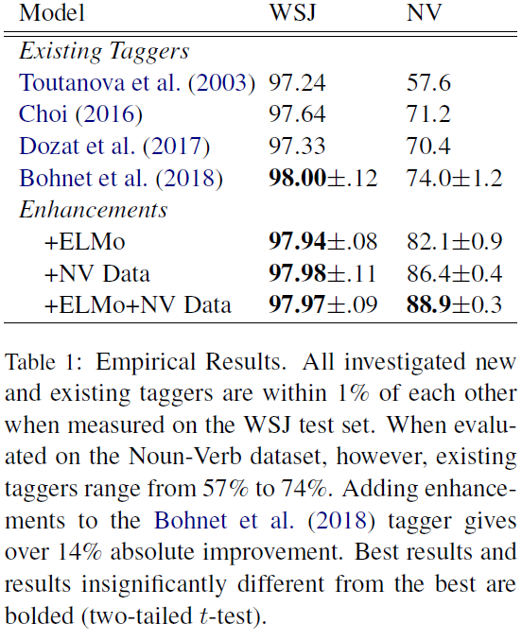
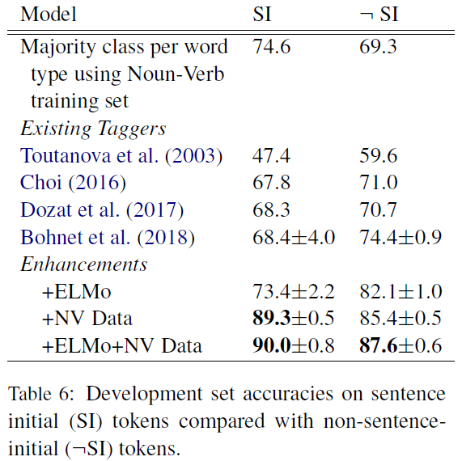
Model Enhancement
Empirical Performances w/ and wo/ enhancements
Contextual word embeddings
Data Augmentation
Above together

Slide 9
Conclusion
Dataset Collection:
annotated by humans;
filtering trivial examples;
focusing on a specific direction, e.g. noun-verb ambiguation.
Model Enhancement:
incorporating contextual information;
More training and real-world data.

